Slide 1

An Analysis of
Facebook Photo Caching
Qi Huang, Ken Birman, Robbert van Renesse (Cornell),
Wyatt Lloyd (Princeton, Facebook),
Sanjeev Kumar, Harry C. Li (Facebook)

Slide 2


250 Billion* Photos on Facebook
Profile
Cache
Layers
Feed
Full-stack
Study
Album
Storage
Backend
* Internet.org, Sept., 2013

Slide 3
Preview of Results
Current Stack Performance
Browser cache is important (reduces 65+% request )
Photo popularity distribution shifts across layers
Opportunities for Improvement
Smarter algorithms can do much better (S4LRU)
Collaborative geo-distributed cache worth trying

Slide 4


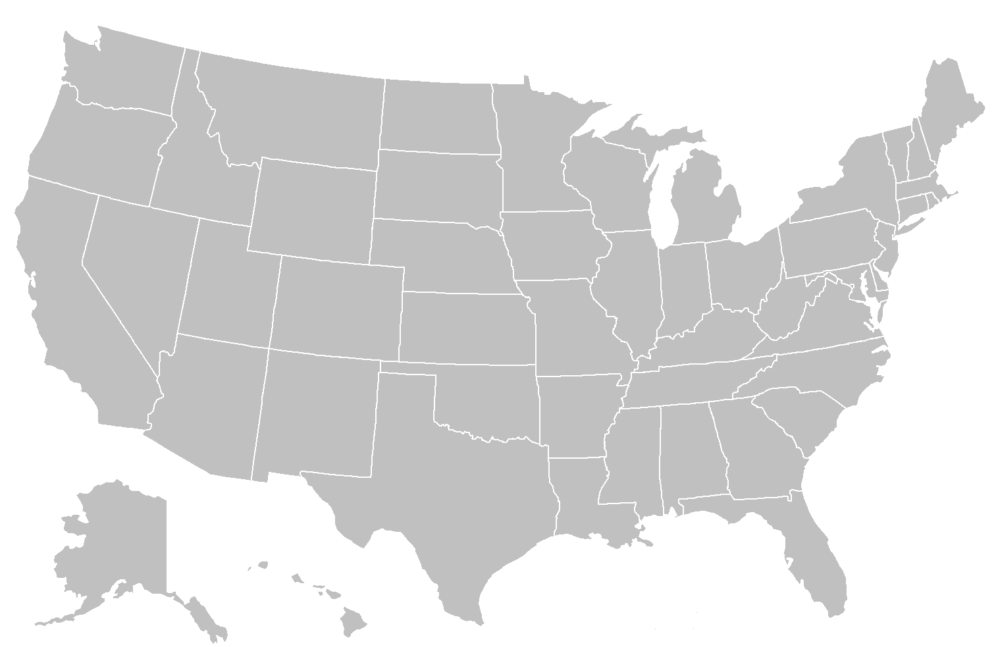
Facebook Photo-Serving Stack
Client

Slide 5
Client-based Browser Cache
Client
Client
Browser
Cache
Local
Fetch

Slide 6
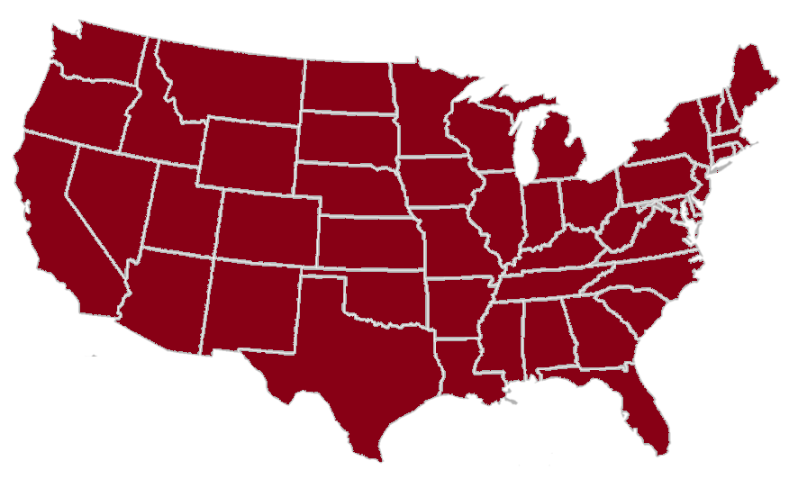
Client-based Browser Cache
Client
Client
Browser
Cache
(Millions)

Slide 7
Stack Choice
Client
Facebook Stack
Browser
Cache
Caches
Storage
(Millions)
Akamai
Content Distribution Network
(CDN)
Focus: Facebook stack

Slide 8
Geo-distributed Edge Cache (FIFO)
Client
PoP
Browser
Cache
Edge
Cache
(Millions)
(Tens)

Slide 9
Geo-distributed Edge Cache (FIFO)
Client
PoP
Browser
Cache
Edge
Cache
(Millions)
(Tens)
Purpose
Reduce cross-country latency
Reduce Data Center bandwidth

Slide 10
Geo-distributed Edge Cache (FIFO)
Client
PoP
Browser
Cache
Edge
Cache
(Millions)
(Tens)

Slide 11
Geo-distributed Edge Cache (FIFO)
Client
PoP
Browser
Cache
Edge
Cache
(Millions)
(Tens)

Slide 12
Single Global Origin Cache (FIFO)
Client
PoP
Data Center
Browser
Cache
Edge
Cache
Origin
Cache
(Millions)
(Tens)
(Four)

Slide 13
Single Global Origin Cache (FIFO)
Client
PoP
Data Center
Browser
Cache
Edge
Cache
Origin
Cache
(Millions)
(Tens)
(Four)
Purpose
Minimize I/O-bound operations

Slide 14
Single Global Origin Cache (FIFO)
Client
PoP
Data Center
Browser
Cache
Edge
Cache
Origin
Cache
(Millions)
(Tens)
(Four)
Hash(url)

Slide 15
Single Global Origin Cache (FIFO)
Client
PoP
Data Center
Browser
Cache
Edge
Cache
Origin
Cache
(Millions)
(Tens)
(Four)

Slide 16
Haystack Backend
Client
PoP
Data Center
Browser
Cache
Edge
Cache
Origin
Cache
Backend (Haystack)
(Millions)
(Tens)
(Four)

Slide 17
How did we collect the trace?

Slide 18
Trace Collection
Client
PoP
Data Center
Instrumentation Scope
Browser
Cache
Edge
Cache
Origin
Cache
Backend (Haystack)
(Object-based sampling)
Request-based: collect X% of requests
Object-based: collect reqs for X% objects

Slide 19
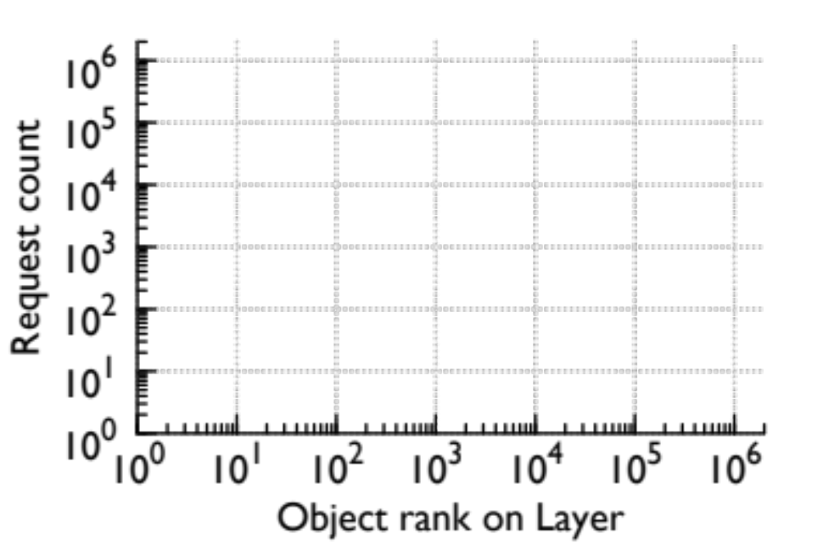
Sampling on Power-law
Object rank

Slide 20
Sampling on Power-law
Req-based
Object rank
Req-based: bias on popular content, inflate cache perf

Slide 21
Sampling on Power-law
Object-based
Object rank
Object-based: fair coverage of unpopular content

Slide 22
Sampling on Power-law
Object-based
Object rank
Object-based: fair coverage of unpopular content

Slide 23
Trace Collection
Client
PoP
Data Center
Instrumentation Scope
Browser
Cache
Edge
Cache
Origin
Cache
Backend (Haystack)
R
Resizer
1.4M photos, all reqs for each
2.6M photo objects, all reqs for each
77.2M reqs
(Desktop)
12.3M
Browsers
12.3K
Servers

Slide 24
Analysis
Traffic sheltering effects of caches
Photo popularity distribution
Size, algorithm, collaborative Edge
In paper
  Stack performance as a function of photo age
  Stack performance as a function of social connectivity
  Geographical traffic flow

Slide 25
Traffic Sheltering
Client
PoP
Data Center
Browser
Cache
Edge
Cache
Origin
Cache
Backend (Haystack)
R
77.2M
26.6M
65.5%
11.2M
58.0%
7.6M
31.8%
Traffic Share
65.5%
20.0%
4.6%
9.9%

Slide 26
Photo popularity and its cache impact

Slide 27
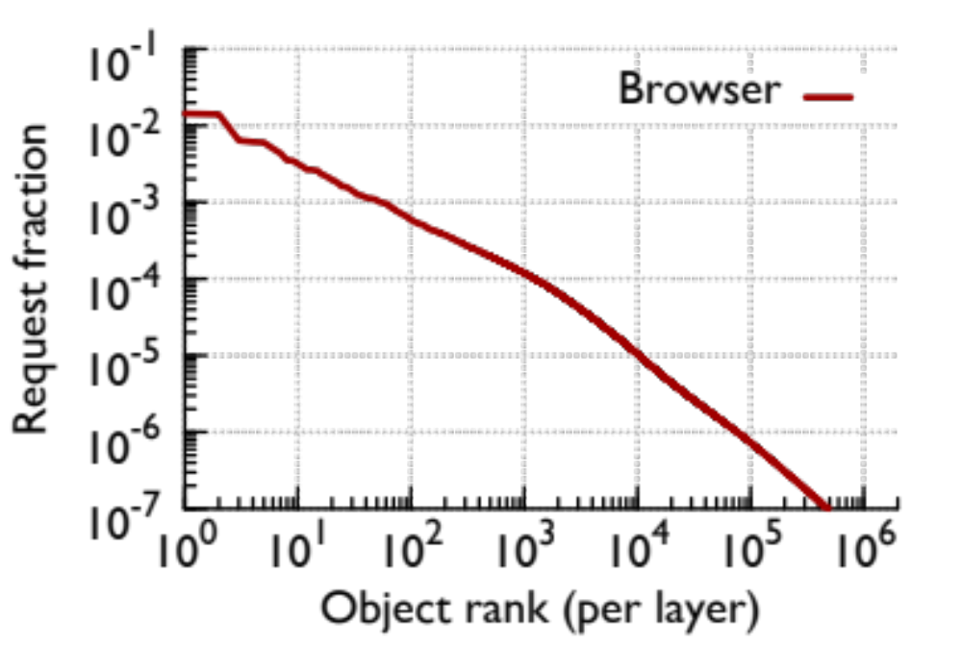
Popularity Distribution
2%
Browser resembles a power-law distribution

Slide 28
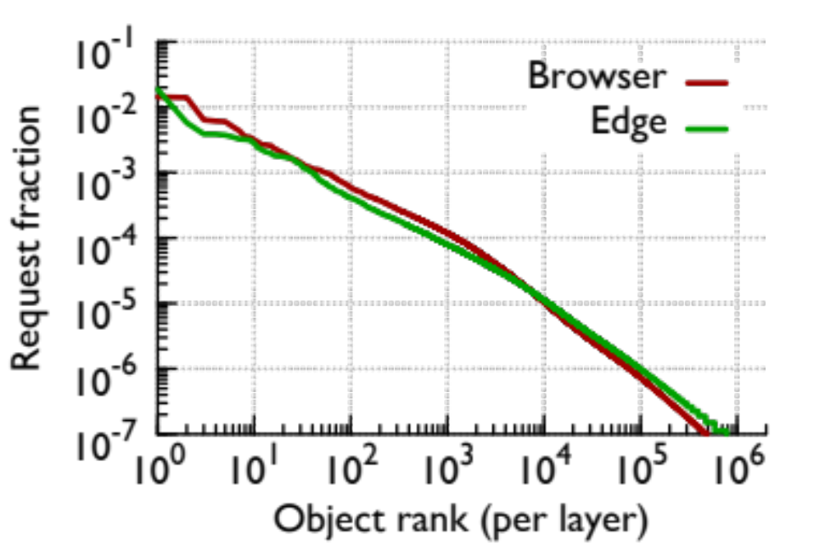
Popularity Distribution
“Viral” photos becomes the head for Edge

Slide 29
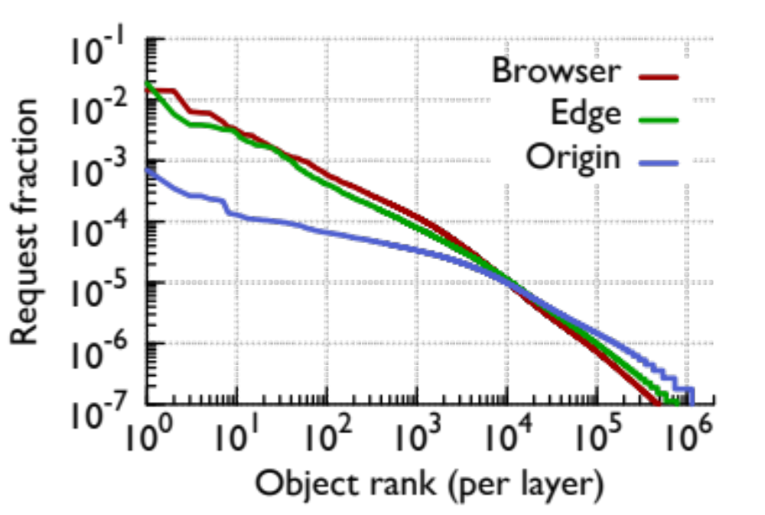
Popularity Distribution
Skewness is reduced after layers of cache

Slide 30
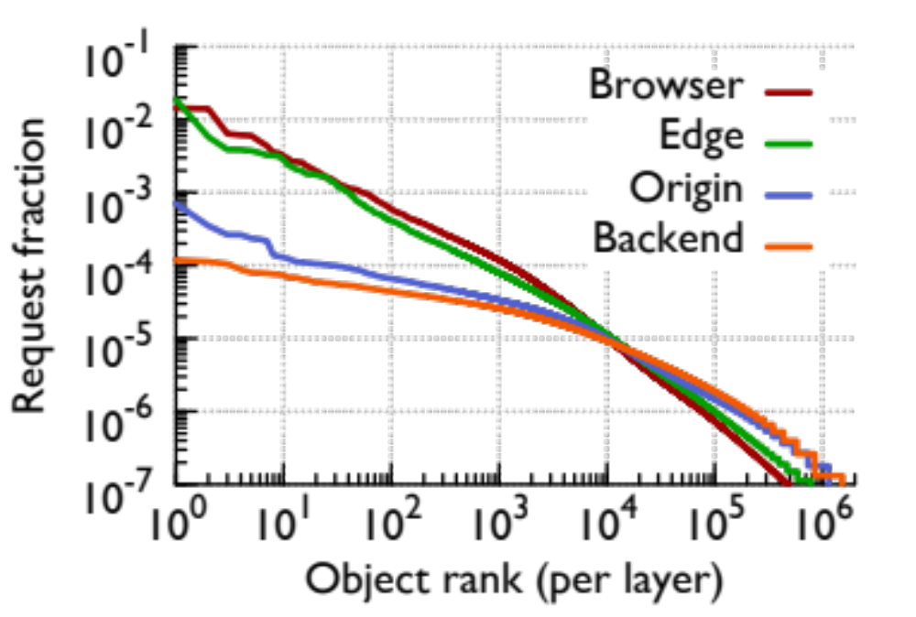
Popularity Distribution
Backend resembles a stretched exponential dist.

Slide 31
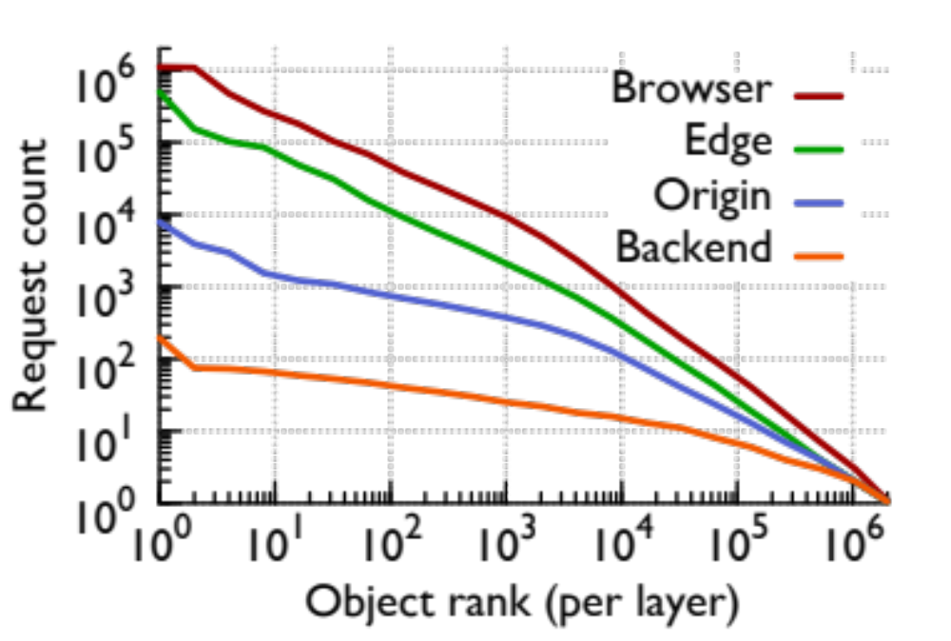
Popularity with Absolute Traffic
Storage/cache designers: pick a layer

Slide 32
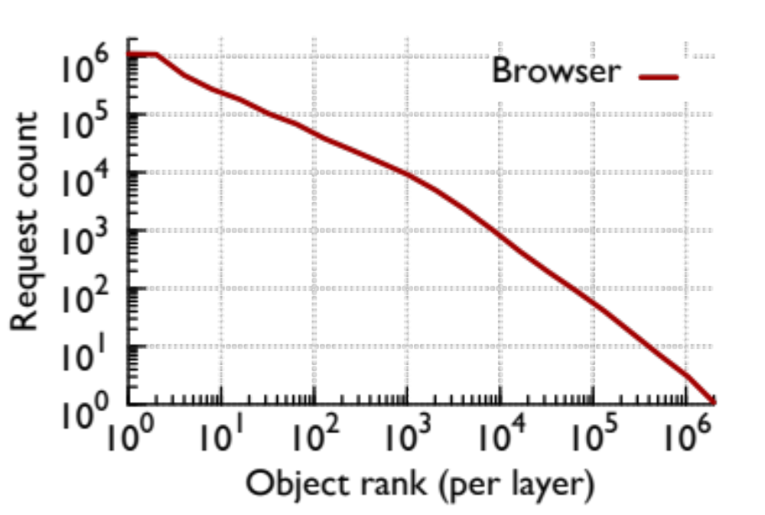
Popularity Impact on Caches
High
M
Low
Lowest
Each has 25% requests

Slide 33
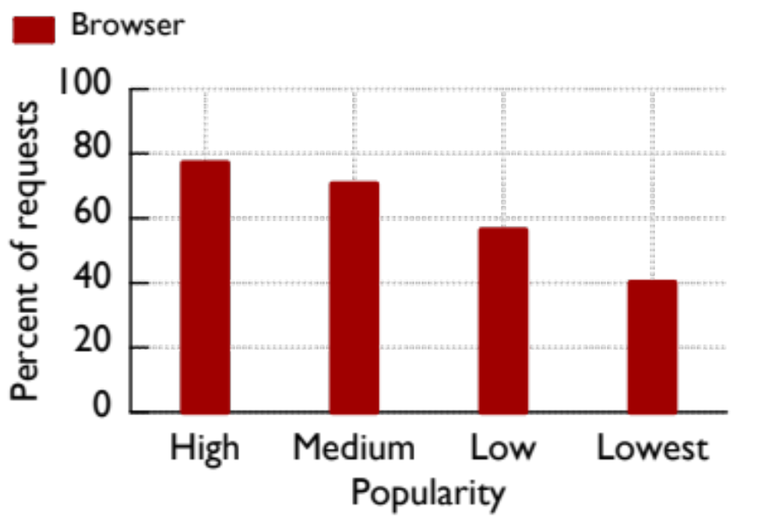
Popularity Impact on Caches
Browser traffic share decreases gradually

Slide 34
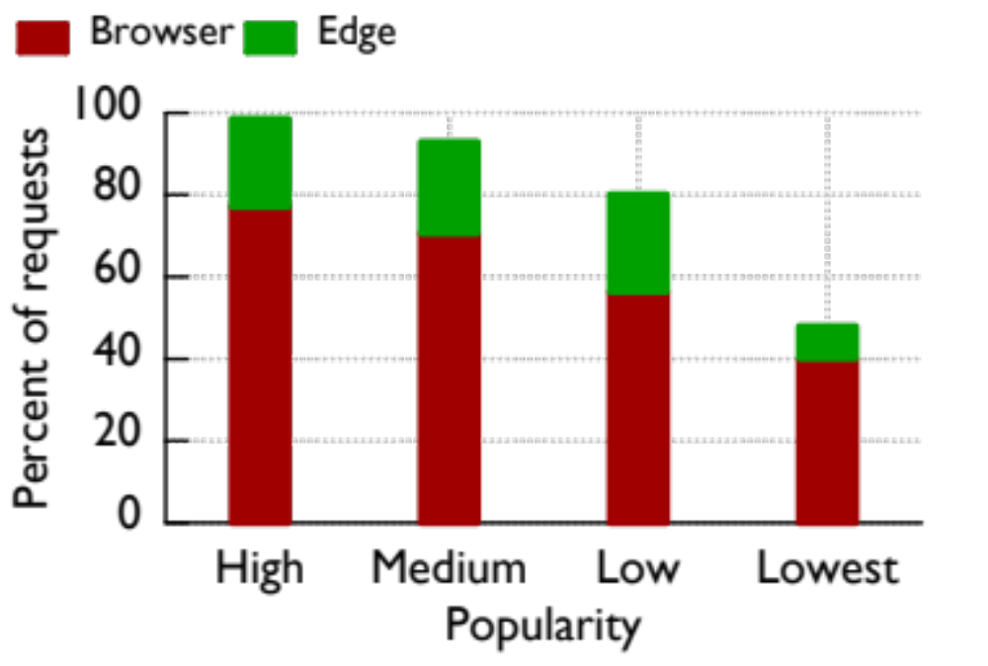
Popularity Impact on Caches
22~23%
7.8%
Edge serves consistent share except for the tail

Slide 35
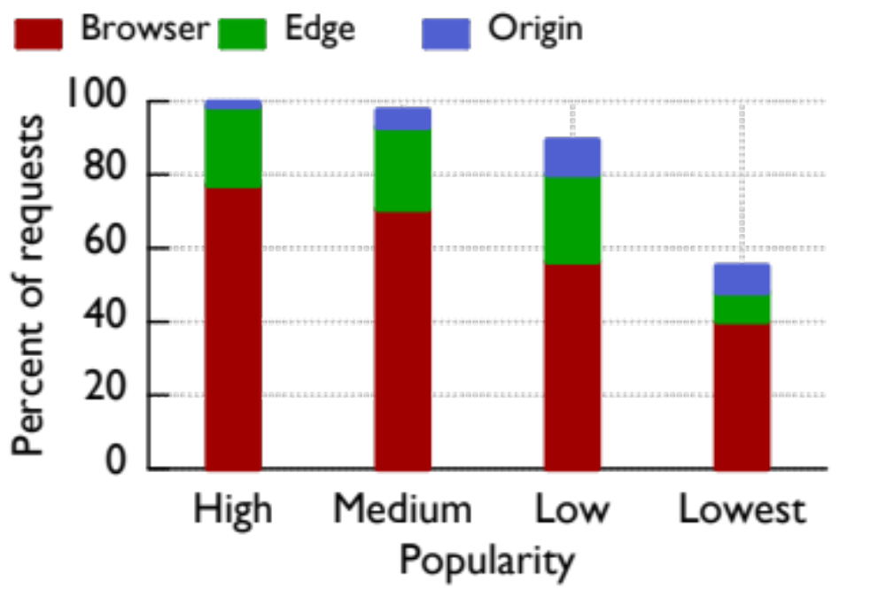
Popularity Impact on Caches
9.3%
Origin contributes most for “low” group

Slide 36
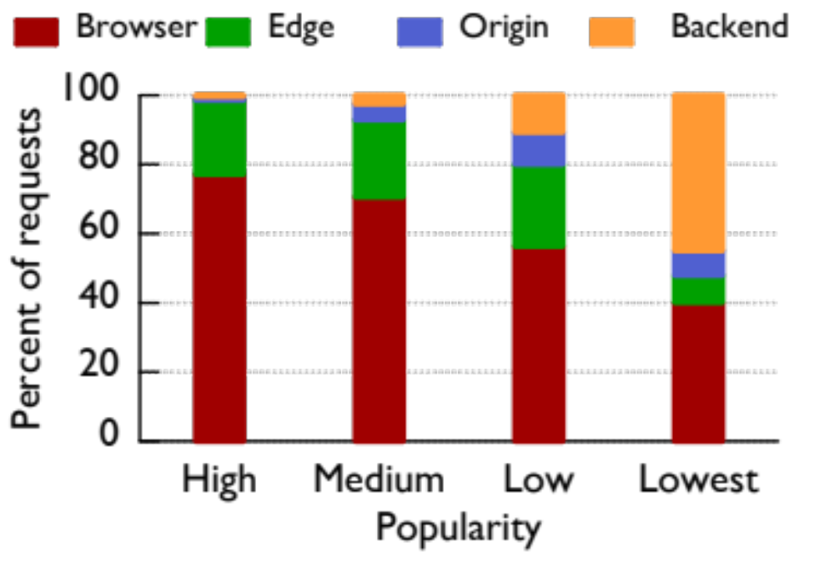
Popularity Impact on Caches
70% Haystack
Backend serves the tail

Slide 37
Can we make the cache better?

Slide 38
Simulation
Replay the trace (25% warm up)
Estimate the base cache size
Evaluate two hit-ratios (object-wise, byte-wise)

Slide 39
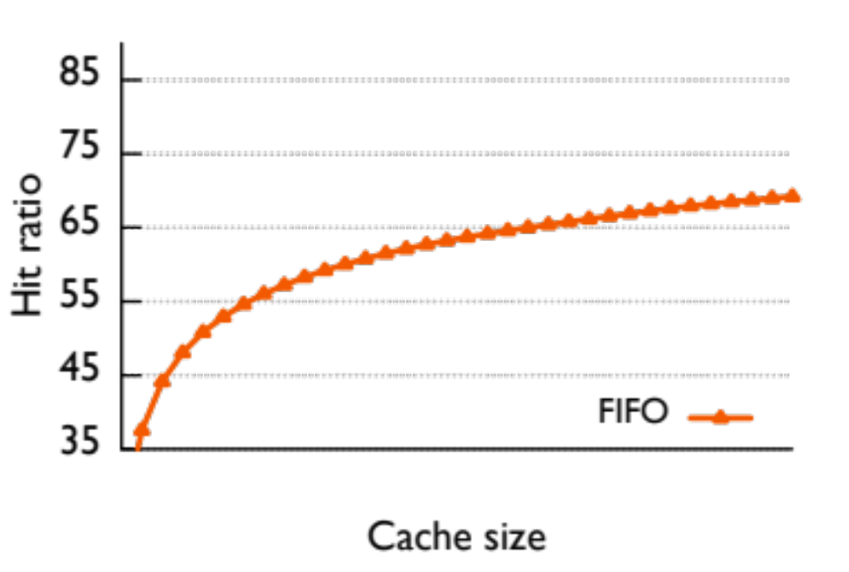
Edge Cache with Different Sizes
59%
Picked San Jose edge (high traffic, median hit ratio)

Slide 40
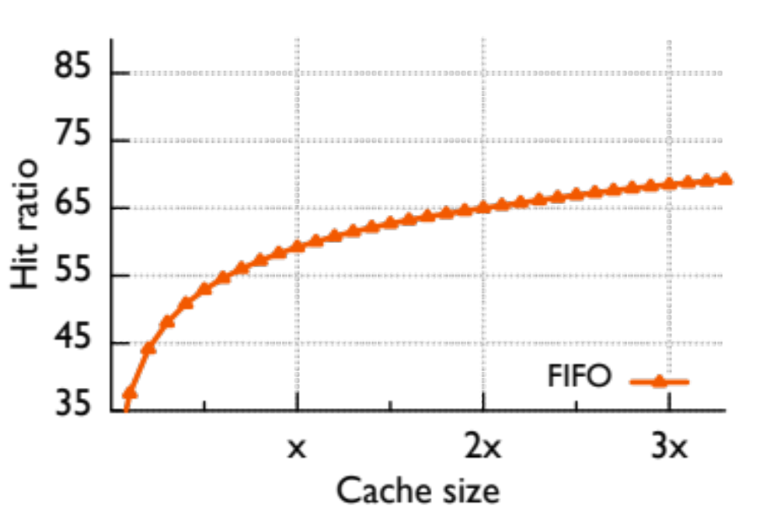
Edge Cache with Different Sizes
68%
65%
59%
“x” estimates current deployment size (59% hit ratio)

Slide 41
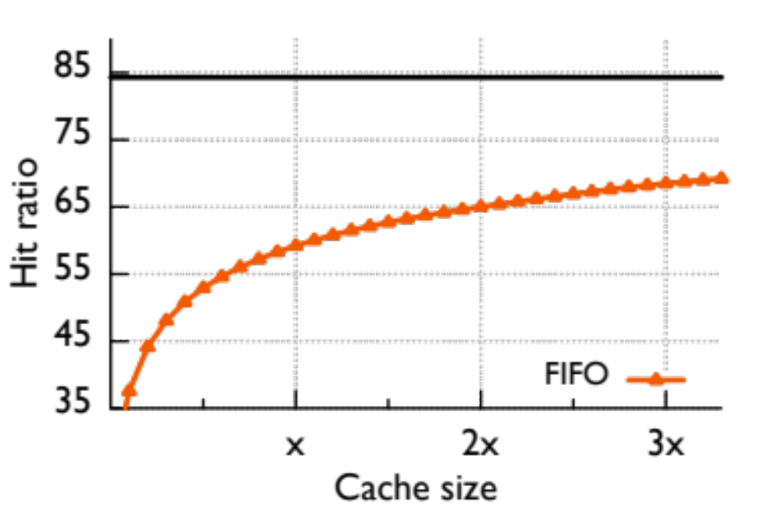
Edge Cache with Different Sizes
Infinite Cache
68%
65%
59%
“Infinite” size ratio needs 45x of current capacity

Slide 42
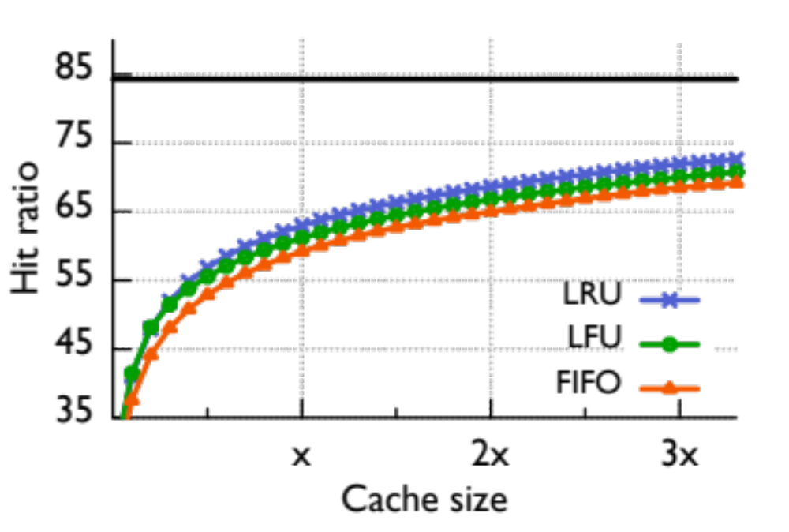
Edge Cache with Different Algos
Infinite Cache
Both LRU and LFU outperforms FIFO slightly

Slide 43
S4LRU
Cache Space
L3
More Recent
L2
L1
L0

Slide 44
S4LRU
Cache Space
L3
More Recent
L2
L1
L0
Missed Object

Slide 45
S4LRU
Cache Space
L3
Hit
More Recent
L2
L1
L0

Slide 46
S4LRU
Cache Space
L3
Evict
More Recent
L2
L1
L0

Slide 47
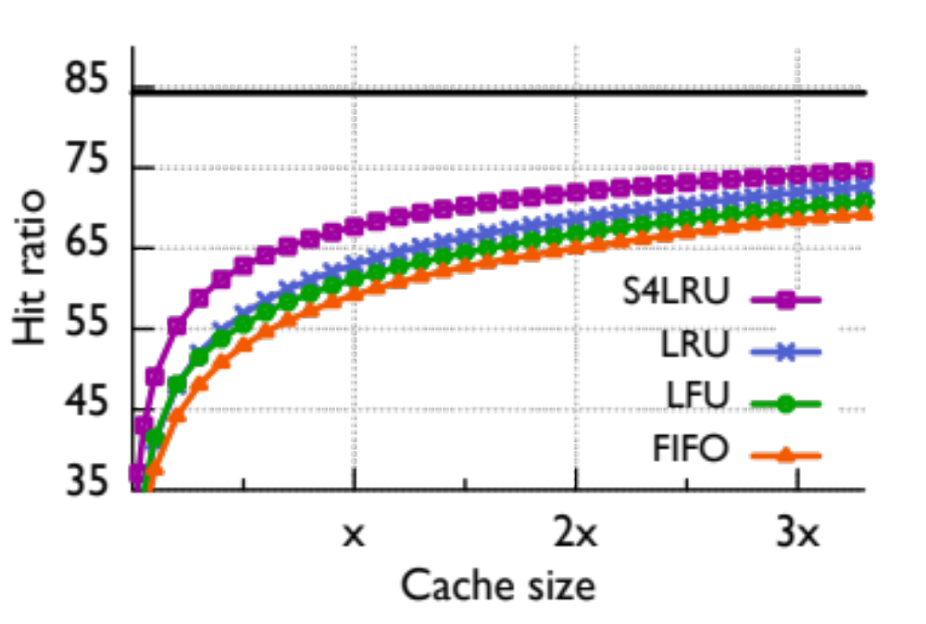
Edge Cache with Different Algos
Infinite Cache
68%
59%
1/3x
S4LRU improves the most

Slide 48
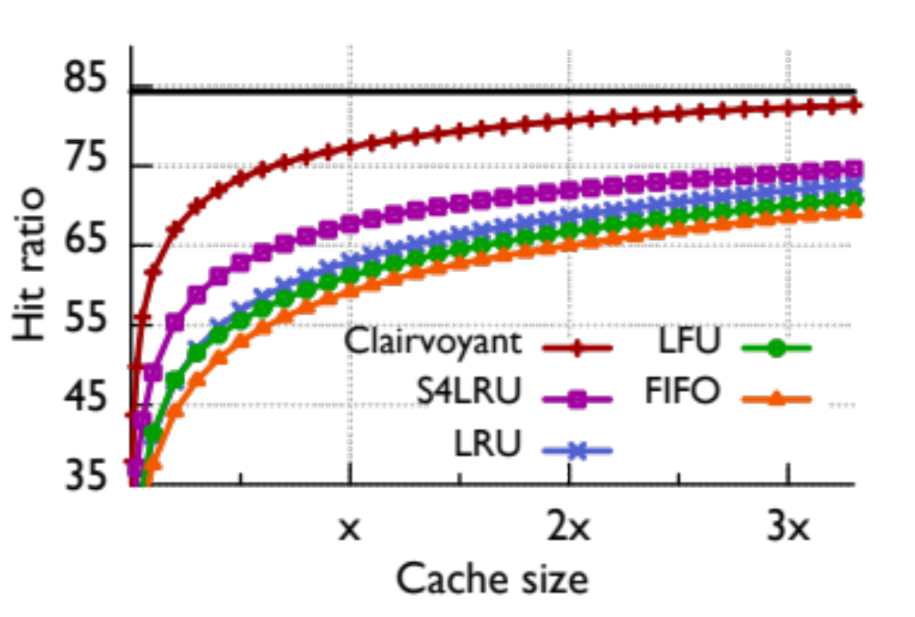
Edge Cache with Different Algos
Infinite Cache
Clairvoyant (Bélády) shows much improvement space

Slide 49
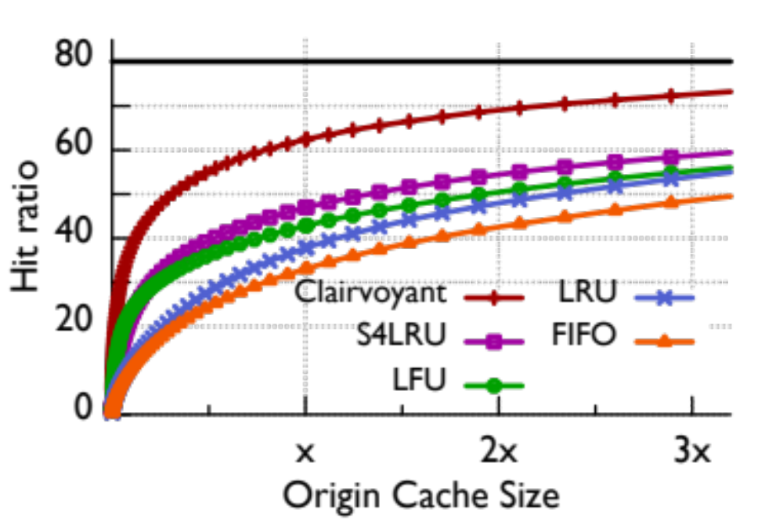
Origin Cache
Infinite Cache
14%
S4LRU improves Origin more than Edge

Slide 50
Which Photo to Cache
Recency & frequency leads S4LRU
Does age, social factors also play a role?

Slide 51
Collaborative cache on the Edge

Slide 52
Geographic Coverage of Edge
Small working set

Slide 53
Geographic Coverage of Edge
9 Edges with high-volume traffic

Slide 54
Geographic Coverage of Edge
Do clients stay with local Edge?

Slide 55
Geographic Coverage of Edge
Atlanta

Slide 56
Geographic Coverage of Edge
Atlanta has 80% requests served by remote Edges
5% NYC
10% Chicago
5% California
35% D.C.
Atlanta
20% local
5% Dallas
20% Miami

Slide 57
Geographic Coverage of Edge
Substantial remote traffic is normal
NYC
35% local
Chicago
60% local
Atlanta
20% local
LA
18% local
Miami
35% local
Dallas
50% local

Slide 58
Geographic Coverage of Edge
Amplified working set

Slide 59
Collaborative Edge

Slide 60
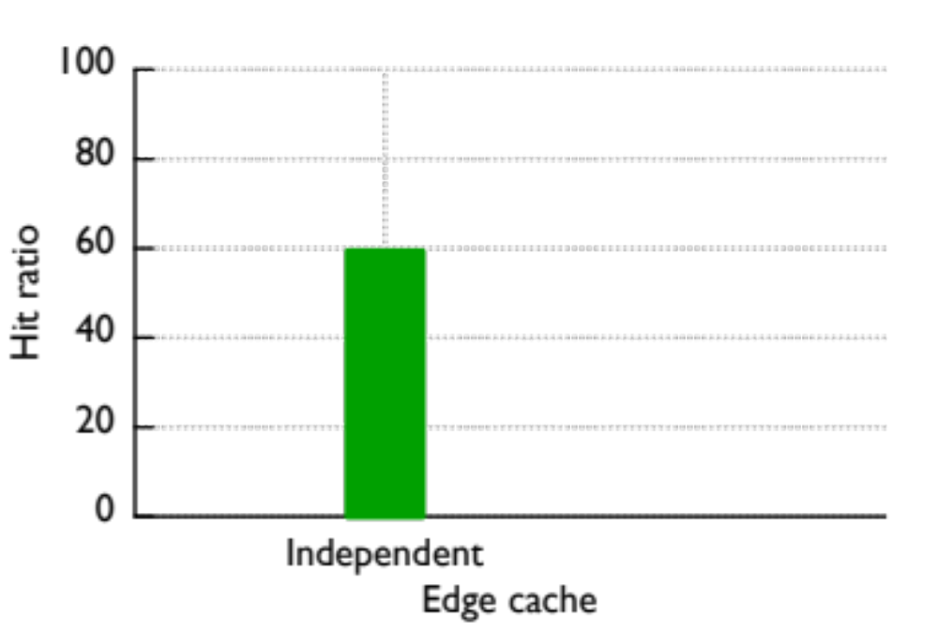
Collaborative Edge
“Independent” aggregates all high-volume Edges

Slide 61
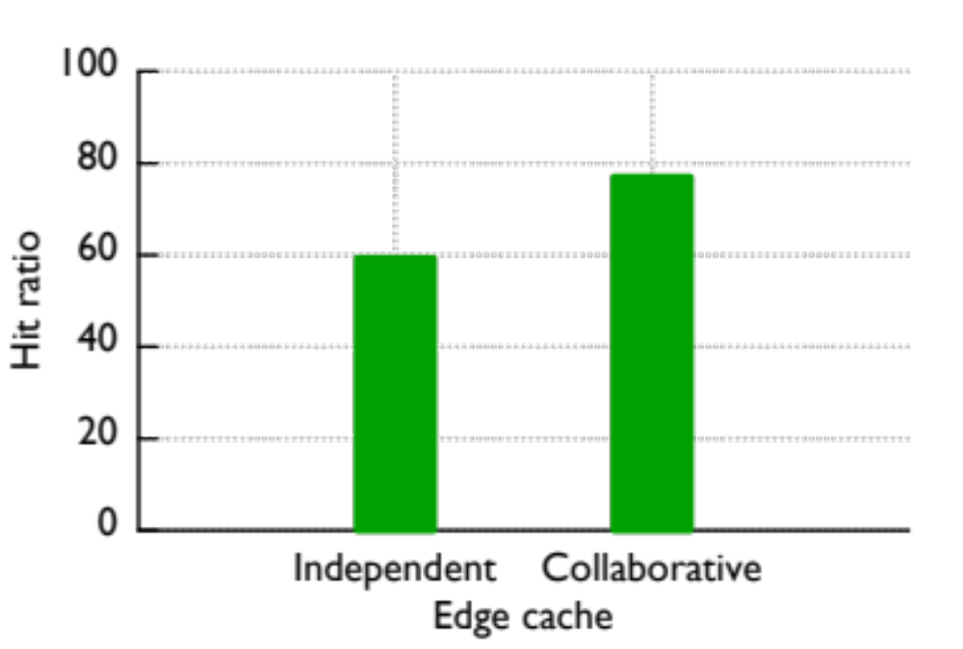
Collaborative Edge
18%
Collaborative
“Collaborative” Edge increases hit ratio by 18%

Slide 62
Related Work
Storage Analysis
BSD file system (SOSP ’85), Sprite ( SOSP ’91), NT (SOSP ’99),
NetApp (SOSP ’11), iBench (SOSP ’11)
Content Distribution Analysis
Cooperative caching (SOSP ’99), CDN vs. P2P (OSDI ’02),
P2P (SOSP ’03), CoralCDN (NSDI ’10), Flash crowds (IMC ’11)
Web Analysis
Zipfian (INFOCOM ’00), Flash crowds (WWW ’02),
Modern web traffic (IMC ’11)

Slide 63
Conclusion
Quantify caching performance
Quantify popularity changes across layers of caches
Recency, frequency, age, social factors impact cache
Outline potential gain of collaborative caching

